Slide 1
Relational Database Design

Slide 2
Introduction to Schema Refinement
What is Schema Refinement?
Schema refinement refers to the process of improving a relational database schema to ensure that:
It avoids data anomalies (insertion, update, and deletion anomalies),
It minimizes redundancy,
It adheres to normal forms, and
It maintains data integrity.

Slide 3
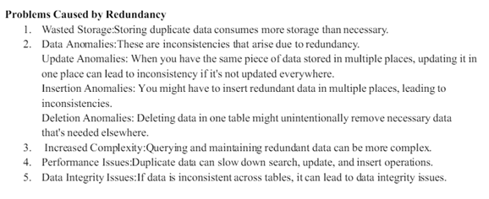

Slide 4

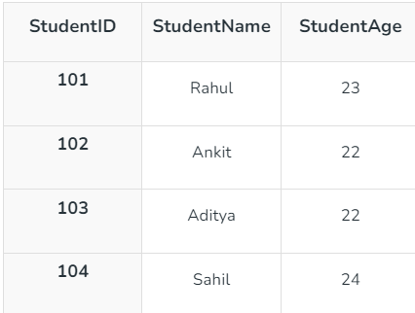
Functional Dependencies
A functional dependency is a constraint that specifies the relationship between two sets of attributes where one set can accurately determine the value of other sets.
It is denoted as X → Y, where X is a set of attributes that is capable of determining the value of Y.
The attribute set on the left side of the arrow, X is called Determinant, while on the right side, Y is called the Dependent.
Example:
Consider a table named Students with the following attributes:
StudentID
StudentName
StudentAge
If each student has a unique StudentID, and this ID determines the student's name, we can express this functional dependency as:
StudentID → StudentName
This indicates that knowing the StudentID allows us to determine the StudentName.

Slide 5
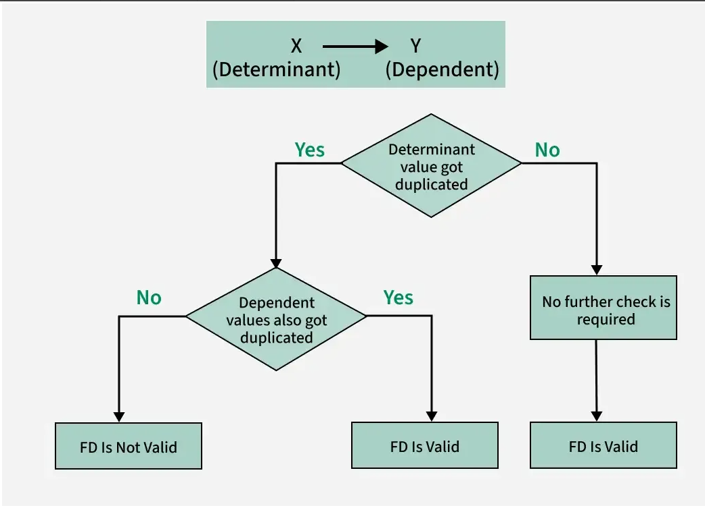

Slide 6
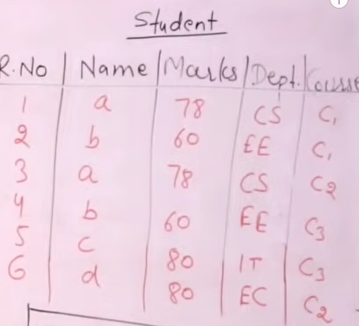
Example

Slide 7
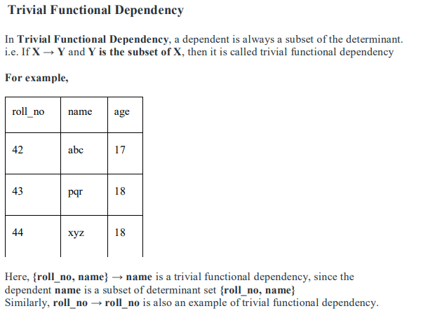

Slide 8
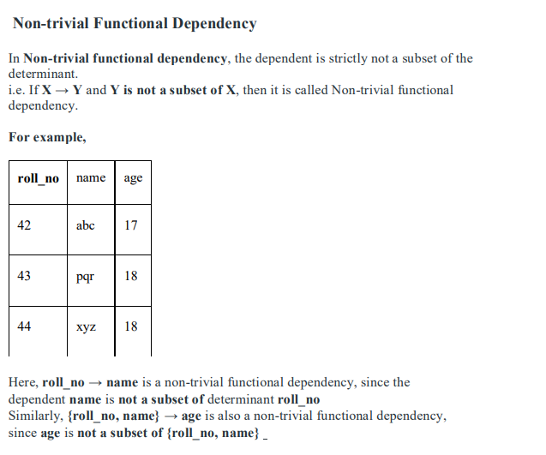

Slide 9
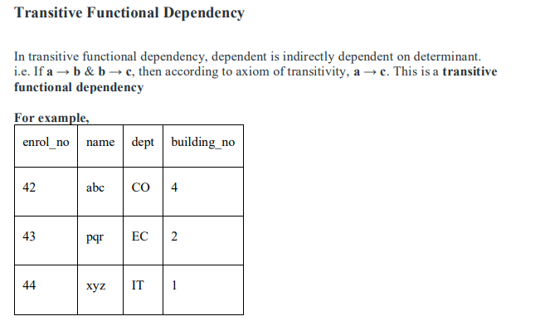
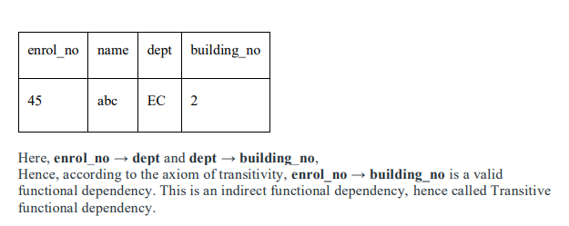

Slide 10
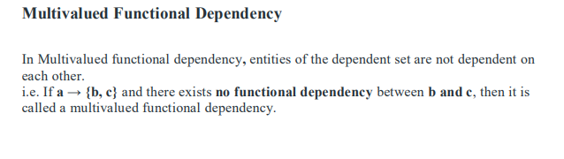
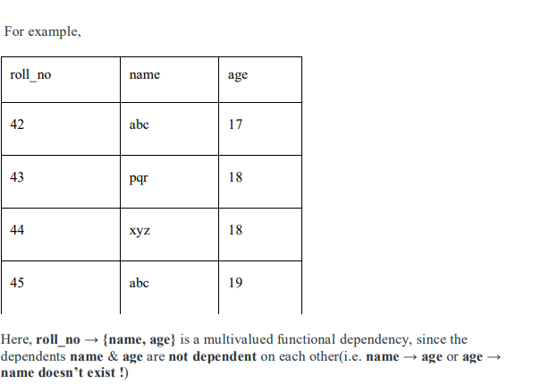

Slide 11
Closure of a Set of FDs
Definition:
Let F be a set of functional dependencies on a relation R. Then F⁺ is the closure of F, i.e., all FDs that can be inferred from F using Armstrong’s Axioms.
These are the rules used to infer additional FDs from a given set:
Reflexivity: If Y ⊆ X, then X → Y
Augmentation: If X → Y, then XZ → YZ
Transitivity: If X → Y and Y → Z, then X → Z
Other derived rules:
Union: If X → Y and X → Z, then X → YZ
Decomposition: If X → YZ, then X → Y and X → Z
Pseudo Transitivity:
If X → Y and YZ → W, then XZ → W

Slide 12
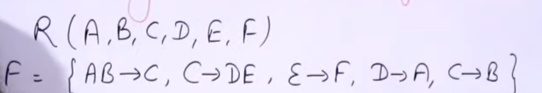
Find Candidate Keys in relation:

Slide 13
Normalization
There is less repetition of data,
A large set of data is structured into a bunch of smaller tables,
and the tables have a proper relationship between them.
Why we need Normalization in DBMS?
Normalization is required for,
Eliminating redundant(useless) data, therefore handling data integrity, because if data is repeated it increases the chances of inconsistent data.
Normalization helps in keeping data consistent by storing the data in one table and referencing it everywhere else.
Breaking down large tables into smaller tables with relationships, so it makes the database structure more scalable and adaptable.
Ensuring data dependencies make sense i.e. data is logically stored.

Slide 14
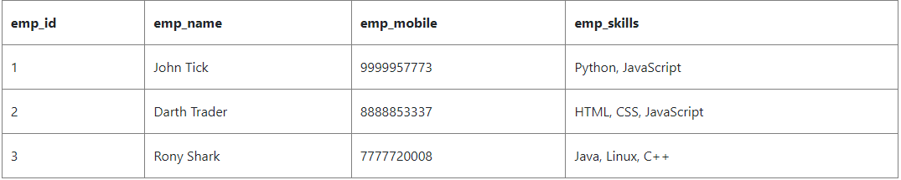
Types of DBMS Normal forms
1. First Normal Form (1NF)
For a table to be in the First Normal Form, it should follow the following 4 rules:
It should only have single(atomic) valued attributes/columns.
Values stored in a column should be of the same domain.
All the columns in a table should have unique names.
And the order in which data is stored should not matter.
The above table has 4 columns:
All the columns have different names.
All the columns hold values of the same type like emp_name has all the names, emp_mobile has all the contact numbers, etc.
The order in which we save data doesn't matter
But the emp_skills column holds multiple comma-separated values, while as per the First Normal form, each column should have a single value.

Slide 15
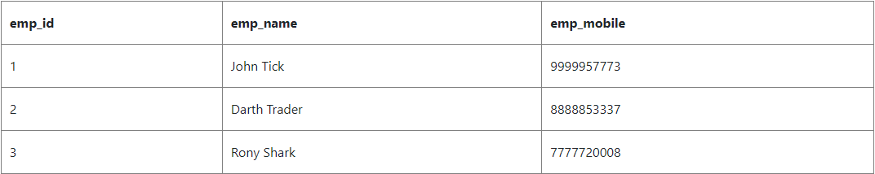
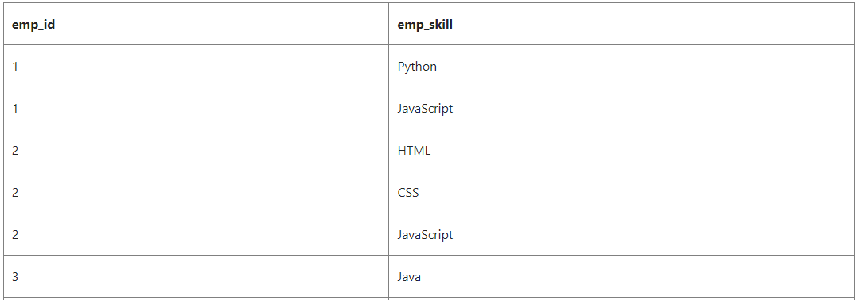
Types of DBMS Normal forms
Create Separate tables for Employee and Employee Skills

Slide 16
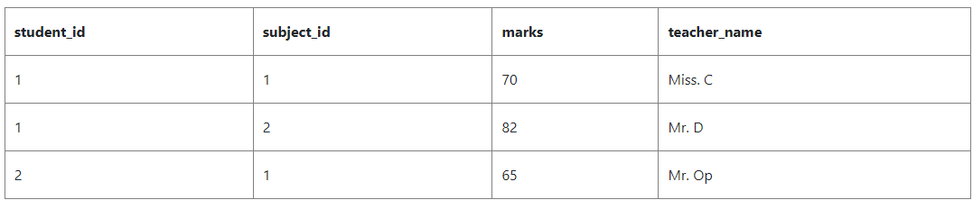
Types of DBMS Normal forms
2. Second Normal Form (2NF)
For a table to be in the Second Normal Form,
It should be in the First Normal form.
And, it should not have Partial Dependency.
What is Partial Dependency?
When a table has a primary key that is made up of two or more columns, then all the columns(not included in the primary key) in that table should depend on the entire primary key and not on a part of it. If any column(which is not in the primary key) depends on a part of the primary key then we say we have Partial dependency in the table.

Slide 17
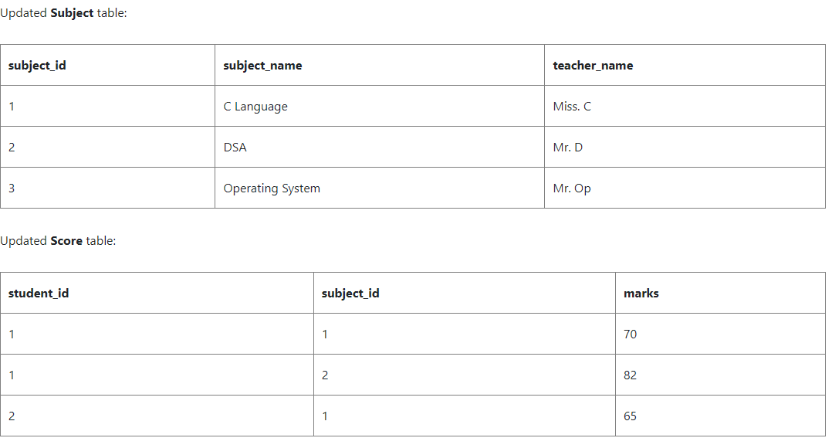
Types of DBMS Normal forms

Slide 18
Types of DBMS Normal forms
3. Third Normal Form (3NF)
A table is said to be in the Third Normal Form when,
It satisfies the First Normal Form and the Second Normal form.
And, it doesn't have Transitive Dependency.

Slide 19
Types of DBMS Normal forms
4. Boyce-Codd Normal Form (BCNF)
Boyce and Codd Normal Form is a higher version of the Third Normal Form.
This form deals with a certain type of anomaly that is not handled by 3NF.
A 3NF table that does not have multiple overlapping candidate keys is said to be in BCNF.
For a table to be in BCNF, the following conditions must be satisfied:
R must be in the 3rd Normal Form
and, for each functional dependency ( X → Y ), X should be a Super Key.

Slide 20
Use of Decompositions
What is Decompositions?
Decomposition in the context of database design refers to the process of breaking down a single table into multiple tables in order to eliminate redundancy, reduce data anomalies, and achieve normalization.
Example:
Student Table
StudentID | Name | Course | Instructor
101 | Alice | DBMS | Dr. Smith
102 | Bob | Networking | Dr. Allen
103 | Carol | DBMS | Dr. Smith

Slide 21
Use of Decompositions
Decomposition into 2 Relations
StudentID | Name | Course
101 | Alice | DBMS
102 | Bob | Networking
103 | Carol | DBMS
Course | Instructor
DBMS | Dr. Smith
Networking | Dr. Allen

Slide 22
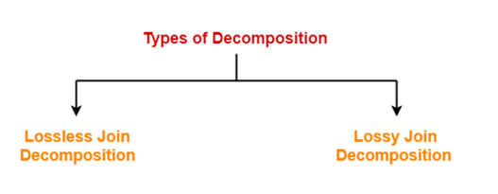
Types of Decomposition

Slide 23
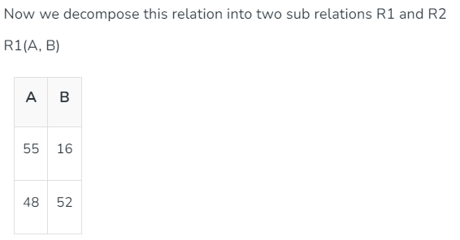
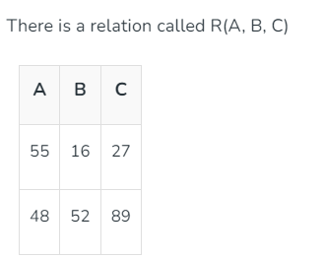
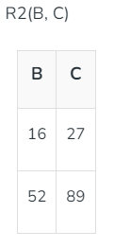
Lossless Decomposition
The process in which where we can regain the original relation R with the help of joins from the multiple relations formed after decomposition. This process is termed as lossless decomposition. It is used to remove the redundant data from the database while retaining the useful information. The lossless decomposition tries to ensure following things:
While regaining the original relation, no information should be lost.
If we perform join operation on the sub-divided relations, we must get the original relation.

Slide 24
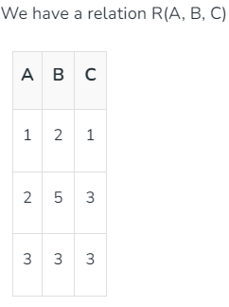
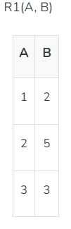


Lossy Decomposition
lossy decomposition means when we perform join operation on the sub-relations it doesn't result to the same relation which was decomposed. After the join operation, we always found some extraneous tuples. These extra tuples genrates difficulty for the user to identify the original tuples.

Slide 25
Dependency preserving property
Dependency preservation in a Database Management System (DBMS) refers to the property of a relational schema decomposition where all original functional dependencies (FDs) are either directly present in one of the decomposed relations or can be inferred from the FDs of the decomposed relations.
Example:
Consider a relation R(A, B, C) with the following functional dependencies: A -> B and B -> C.
Now, let's decompose R into two relations:
R1(A, B)
R2(B, C)
To check for dependency preservation, we examine the FDs in the decomposed relations:
In R1(A, B), the FD A -> B is preserved.
In R2(B, C), the FD B -> C is preserved.
Since both original FDs (A -> B and B -> C) are directly present in the decomposed relations, this decomposition is dependency-preserving. We can verify these dependencies by checking only R1 and R2 individually, without requiring a join operation.

Slide 26
Dependency preserving property
Example
Consider a relation R(A, B, C, D) with the FD A -> CD. If we decompose R into:
R1(A, B)
R2(C, D)
In this case, the original FD A -> CD is not directly present in either R1 or R2. Furthermore, it cannot be inferred from the FDs within R1 or R2 (since A is only in R1 and C, D are only in R2). Therefore, this decomposition is not dependency-preserving, as we would need to join R1 and R2 to enforce the A -> CD dependency.

